Slide 1
Encode Data and Transform Data
Artificial Intelligence
Week 4

Slide 2
Agenda
Time | Activity
10 min | Encoding
30 | Missing data
120 min | Machine Learning Pipeline

Slide 3
Encoding Categorical Features
An encoding method is needed to convert non numeric features to numeric. Below are some of the methods.
Leave-One-hot Encoding
One-hot Encoding
Binary encoding
Hash encoding
BaseN
Sum
Ordinal

Slide 4
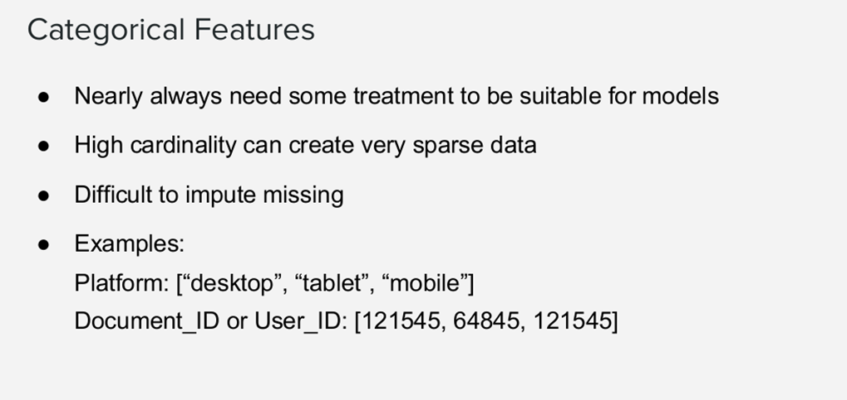

Slide 5
Encoding
from numpy import array
from sklearn.preprocessing import LabelEncoder
# define example
data = ['warm','hot','cold','luke warm','hot','cold','warm']
values = array(data)
print(values)
# integer encode
label_encoder = LabelEncoder()
integer_encoded = label_encoder.fit_transform(values)
print(integer_encoded)
inverted = label_encoder.inverse_transform(integer_encoded)[2]
print(inverted)

Slide 6
One-hot encoding
# binary encode
onehot_encoder = OneHotEncoder(sparse=False)
integer_encoded = integer_encoded.reshape(len(integer_encoded), 1)
onehot_encoded = onehot_encoder.fit_transform(integer_encoded)
print(onehot_encoded)
# invert first example
inverted = label_encoder.inverse_transform([argmax(onehot_encoded[0, :])])
print(inverted)

Slide 7
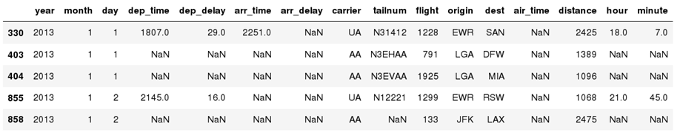
Pandas: Missing Data
Missing values are marked as NaN.
Select the rows that have at least one missing value
flights[flights.isnull().any(axis=1)].head()
Notes:
Ask how containerization differs from virtualization

Slide 8
Pandas: Missing Data
Interpolate NaNs away
df.interpolate()
DataFrame.interpolate(method='linear', axis=0, limit=None, inplace=False, limit_direction='forward', limit_area=None, downcast=None, **kwargs)
method : {‘linear’, ‘time’, ‘index’, ‘values’, ‘nearest’, ‘zero’,‘slinear’, ‘quadratic’, ‘cubic’, ‘barycentric’, ‘krogh’, ‘polynomial’, ‘spline’, ‘piecewise_polynomial’, ‘from_derivatives’, ‘pchip’, ‘akima’}
Notes:
Ask how containerization differs from virtualization

Slide 9
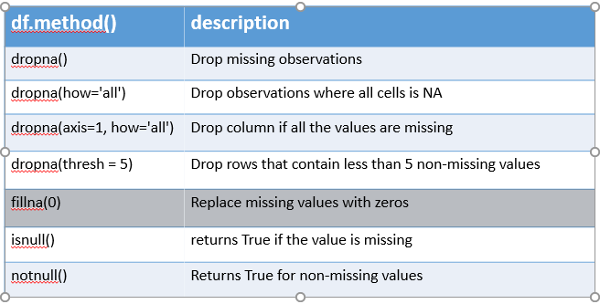
Methods to deal with missing data
Notes:
Ask how containerization differs from virtualization

Slide 10
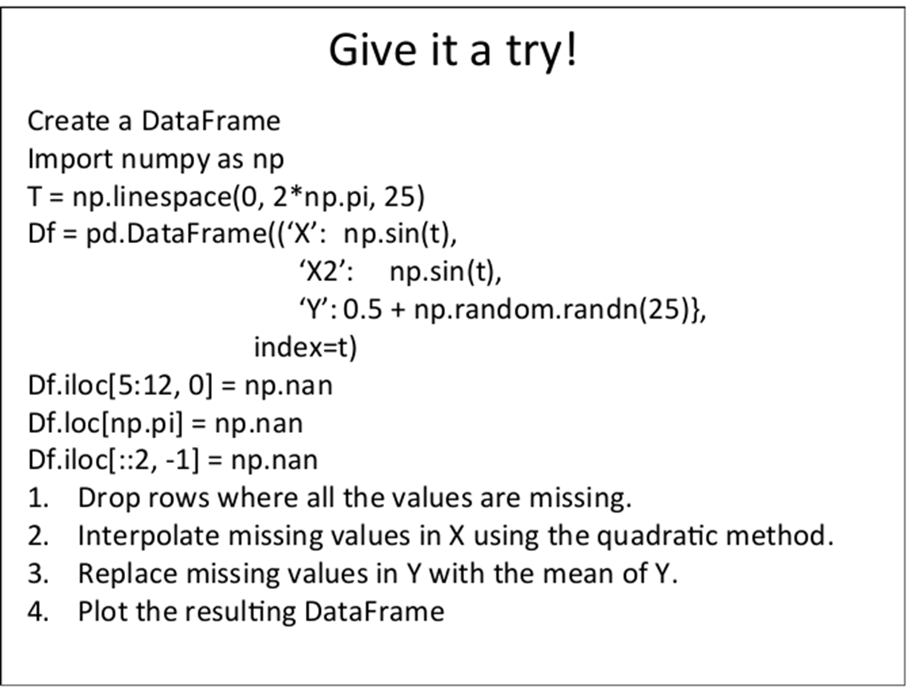
Notes:
Ask how containerization differs from virtualization

Slide 11
Problem
How source code: https://github.com/ageron/handson-ml.

Slide 12
End to End Machine Learning Project
Data: https://raw.githubusercontent.com/ageron/handson-ml/master/datasets/housing/housing.tgz
Colab File

Slide 13
End to End Machine Learning Project
All attributes are numerical, except the ocean_proximity field. Its type is object , so it could hold any kind of Python object, but since you loaded this data from a CSV file you know that it must be a text attribute. When you looked at the top five rows, you probably noticed that the values in that column were repetitive, which means that it is probably a categorical attribute. You can find out what categories exist and how many districts belong to each category by using the value_counts() method:
housing["ocean_proximity"].value_counts()

Slide 14
Describe Function
25% of the districts have a median age lower than 18, while 50% are lower than 29 and 75% are lower than 37. These are often called the 25 th percentile (or 1 st quartile), the median, and the 75 th percentile (or 3 rd quartile).
Another quick way to get a feel of the type of data you are dealing with is to plot a histogram for each numerical attribute
A histogram shows the number of instances (on the vertical axis) that have a given value range (on the horizontal axis)

Slide 15
Histograms
You can either plot this one attribute at a time, or you can call the hist() method on the whole dataset, and it will plot a histogram for each numerical attribute
For example, you can see that slightly over 800 districts have a median_house_value equal to about $500,000.
%matplotlib inline
# only in a Jupyter notebook
import matplotlib.pyplot as plt
housing.hist(bins=50, figsize=(20,15))
plt.show()

Slide 16
Histograms
You can either plot this one attribute at a time, or you can call the hist() method on the whole dataset, and it will plot a histogram for each numerical attribute
For example, you can see that slightly over 800 districts have a median_house_value equal to about $500,000.
%matplotlib inline
# only in a Jupyter notebook
import matplotlib.pyplot as plt
housing.hist(bins=50, figsize=(20,15))
plt.show()

Slide 17
Create a Test Set
from sklearn.model_selection import train_test_split
train_set, test_set = train_test_split(housing, test_size=0.2, random_state=42)
print(len(train_set), "train +", len(test_set), "test")
So far we have considered purely random sampling methods. This is generally fine if your dataset is large enough (especially relative to the number of attributes), but if it is not, you run the risk of introducing a significant sampling bias

Slide 18
Discover and Visualize the Data to Gain Insights
Since there is geographical information (latitude and longitude), it is a good idea to create a scatterplot of all districts to visualize the data
housing.plot(kind="scatter", x="longitude", y="latitude")
This looks like California all right, but other than that it is hard to see any particular pattern. Setting the alpha option to 0.1 makes it much easier to visualize the places where there is a high density of data points
housing.plot(kind="scatter", x="longitude", y="latitude", alpha=0.1)

Slide 19
Discover and Visualize the Data to Gain Insights
Now let’s look at the housing prices. The radius of each circle represents the district’s population (option s ), and the color represents the price (option c ). We will use a predefined color map (option cmap ) called jet , which ranges from blue (low values) to red (high prices):
housing.plot(kind="scatter", x="longitude", y="latitude", alpha=0.4, s=housing["population"]/100, label="population", c="median_house_value", cmap=plt.get_cmap("jet"), colorbar=True, )
plt.legend()

Slide 20
Discover and Visualize the Data to Gain Insights
This image tells you that the housing prices are very much related to the location (e.g., close to the ocean)

Slide 21
Looking for Correlations
Since the dataset is not too large, you can easily compute the standard correlation coefficient (also called Pearson’s r) between every pair of attributes using the corr() method:
corr_matrix = housing.corr()
Now let’s look at how much each attribute correlates with the median house value:
corr_matrix["median_house_value"].sort_values(ascending=False)

Slide 22
Looking for Correlations
The correlation coefficient ranges from –1 to 1. When it is close to 1, it means that there is a strong positive correlation; for example, the median house value tends to go up when the median income goes up. When the coefficient is close to –1, it means that there is a strong negative correlation; you can see a small negative correlation between the latitude and the median house value (i.e., prices have a slight tendency to go down when you go north).
Finally, coefficients close to zero mean that there is no linear correlation.
Another way to check for correlation between attributes is to use Pandas’ scatter_matrix function, which plots every numerical attribute against every other numerical attribute

Slide 23
Looking for Correlations
Since there are now 11 numerical attributes, you would get 11 ² = 121 plots, which would not fit on a page
from pandas.plotting import scatter_matrix
attributes = ["median_house_value", "median_income", "total_rooms","housing_median_age"]
scatter_matrix(housing[attributes], figsize=(12, 8))

Slide 24
Feature Augmentation
One last thing you may want to do before actually preparing the data for Machine Learning algorithms is to try out various attribute combinations
For example, the total number of rooms in a district is not very useful if you don’t know how many households there are
What you really want is the number of rooms per household.
Similarly, the total number of bedrooms by itself is not very useful: you probably want to compare it to the number of rooms.
And the population per household also seems like an interesting attribute combination to look at. Let’s create these new attributes:

Slide 25
Feature Augmentation
housing["rooms_per_household"] = housing["total_rooms"]/housing["households"]
housing["bedrooms_per_house"] = housing["total_bedrooms"]/housing["total_rooms"]
housing["population_per_household"]=housing["population"]/housing["households"]
corr_matrix = housing.corr()
corr_matrix["median_house_value"].sort_values(ascending=False)

Slide 26
Feature Augmentation
The new bedrooms_per_room attribute is much more correlated with the median house value than the total number of rooms or bedrooms
Apparently houses with a lower bedroom/room ratio tend to be more expensive.
The number of rooms per household is also more informative than the total number of rooms in a district — obviously the larger the houses, the more expensive they are.

Slide 27
Data For Machine Learning
You noticed earlier that the total_bedrooms attribute has some missing values, so let’s fix this. You have three options:
Get rid of the corresponding districts.
Get rid of the whole attribute.
Set the values to some value (zero, the mean, the median, etc.).
You can accomplish these easily using DataFrame’s dropna() , drop() , and fillna() methods:
housing.dropna(subset=["total_bedrooms"])# option 1
housing.drop("total_bedrooms", axis=1) # option 2
median = housing["total_bedrooms"].median()
housing["total_bedrooms"].fillna(median)# option 3

Slide 28
Data For Machine Learning
If you choose option 3, you should compute the median value on the training set, and use it to fill the missing values in the training set, but also don’t forget to save the median value that you have computed.
Scikit-Learn provides a handy class to take care of missing values: Imputer . Here is how to use it. First, you need to create an Imputer instance, specifying that you want to replace each attribute’s missing values with the median of that attribute:
from sklearn.impute import SimpleImputer
imputer = SimpleImputer(strategy="median")

Slide 29
Data For Machine Learning
Since the median can only be computed on numerical attributes, we need to create a copy of the data without the text attribute ocean_proximity :
housing_num = housing.drop("ocean_proximity", axis=1)
Now you can fit the imputer instance to the training data using the fit() method:
The imputer has simply computed the median of each attribute and stored the result in its statistics_ instance variable. Only the total_bedrooms attribute had missing values, but we cannot be sure that there won’t be any missing values in new data after the system goes live, so it is safer to apply the imputer to all the numerical attributes:
housing_num.median().values
imputer.fit(housing_num)

Slide 30
Data For Machine Learning
Now you can use this “trained” imputer to transform the training set by replacing missing values by the learned medians:
X = imputer.transform(housing_num)
The result is a plain Numpy array containing the transformed features. If you want to put it back into a Pandas DataFrame, it’s simple:
housing_tr = pd.DataFrame(X, columns=housing_num.columns)

Slide 31
Text and Categorical Attributes
Earlier we left out the categorical attribute ocean_proximity because it is a text attribute so we cannot compute its median.
Most Machine Learning algorithms prefer to work with numbers anyway, so let’s convert these text labels to numbers.
Scikit-Learn provides a transformer for this task called LabelEncoder :
from sklearn.preprocessing import LabelEncoder
encoder = LabelEncoder()
housing_cat = housing["ocean_proximity"]
housing_cat_encoded = encoder.fit_transform(housing_cat)
print(encoder.classes_)

Slide 32
Text and Categorical Attributes
One issue with this representation is that ML algorithms will assume that two nearby values are more similar than two distant values.
Obviously this is not the case (for example, categories 0 and 4 are more similar than categories 0 and 1).
To fix this issue, a common solution is to create one binary attribute per category: one attribute equal to 1 when the category is “<1H OCEAN” (and 0 otherwise), another attribute equal to 1 when the category is “INLAND” (and 0 otherwise), and so on.
This is called one-hot encoding, because only one attribute will be equal to 1 (hot), while the others will be 0 (cold).
Scikit-Learn provides a OneHotEncoder encoder to convert integer categorical values into one-hot vectors

Slide 33
Text and Categorical Attributes
Let’s encode the categories as one-hot vectors. Note that fit_transform() expects a 2D array, but housing_cat_encoded is a 1D array, so we need to reshape it:
from sklearn.preprocessing import OneHotEncoder
encoder = OneHotEncoder()
housing_cat_1hot = encoder.fit_transform(housing_cat_encoded.reshape(-1,1))
housing_cat_1hot
Notice that the output is a SciPy sparse matrix, instead of a NumPy array. This is very useful when you have categorical attributes with thousands of categories

Slide 34
Text and Categorical Attributes
Using up tons of memory mostly to store zeros would be very wasteful, so instead a sparse matrix only stores the location of the nonzero elements. You can use it mostly like a normal 2D array but if you really want to convert it to a (dense) NumPy array, just call the toarray() method:
housing_cat_1hot.toarray()
We can apply both transformations (from text categories to integer categories, then from integer
categories to one-hot vectors) in one shot using the LabelBinarizer class:

Slide 35
Text and Categorical Attributes
from sklearn.preprocessing import LabelBinarizer
encoder = LabelBinarizer()
housing_cat_1hot = encoder.fit_transform(housing_cat)
housing_cat_1hot

Slide 36
Feature Scaling
One of the most important transformations you need to apply to your data is feature scaling.
With few exceptions, Machine Learning algorithms don’t perform well when the input numerical attributes have very different scales.
There are two common ways to get all attributes to have the same scale: min-max scaling and standardization.
Min-max scaling (many people call this normalization) is quite simple: values are shifted and rescaled so that they end up ranging from 0 to 1
Scikit-Learn provides a transformer called MinMaxScaler for this

Slide 37
Feature Scaling
Standardization is quite different: first it subtracts the mean value (so standardized values always have a zero mean), and then it divides by the variance so that the resulting distribution has unit variance.
Unlike min-max scaling, standardization does not bound values to a specific range, which may be a problem for some algorithms (e.g., neural networks often expect an input value ranging from 0 to 1).
However, standardization is much less affected by outliers.

Slide 38
Select and Train a Model
The good news is that thanks to all these previous steps, things are now going to be much simpler than you might think. Let’s first train a Linear Regression model
from sklearn.linear_model import LinearRegression
lin_reg = LinearRegression()
lin_reg.fit(housing_prepared, housing_labels)
some_data = housing.iloc[:5]
some_labels = housing_labels.iloc[:5]
print("Predictions:\t", lin_reg.predict(some_data_prepared))
Let’s measure this regression model’s RMSE on the whole training set using Scikit-
Learn’s mean_squared_error function:

Slide 39
How good is the model
A typical performance measure for regression problems is the Root Mean Square Error (RMSE).
It measures the standard deviation of the errors the system makes in its predictions.
For example, an RMSE equal to 50,000 means that about 68% of the system’s predictions fall within $50,000 of the actual value, and about 95% of the predictions fall within $100,000 of the actual value.
Even though the RMSE is generally the preferred performance measure for regression tasks, in some contexts you may prefer to use another function. For example, suppose that there are many outlier districts. In that case, you may consider using the Mean Absolute Error (also called the Average Absolute Deviation;

Slide 40
How good is the model
Both the RMSE and the MAE are ways to measure the distance between two vectors: the vector of predictions and the vector of target values.
from sklearn.metrics import mean_squared_error
housing_predictions = lin_reg.predict(housing_prepared)
lin_mse = mean_squared_error(housing_labels, housing_predictions)
lin_rmse = np.sqrt(lin_mse)
lin_rmse
Okay, this is better than nothing but clearly not a great score: most districts’ median_housing_values range between $120,000 and $265,000, so a typical prediction error of $68,628 is not very satisfying.

Slide 41
How good is the model
This is an example of a model underfitting the training data.
When this happens it can mean that the features do not provide enough information to make good predictions, or that the model is not powerful enough.
Let’s train a DecisionTreeRegressor . This is a powerful model, capable of finding complex nonlinear relationships in the data
from sklearn.tree import DecisionTreeRegressor
tree_reg = DecisionTreeRegressor()
tree_reg.fit(housing_prepared, housing_labels)

Slide 42
How good is the model
housing_predictions = tree_reg.predict(housing_prepared)
tree_mse = mean_squared_error(housing_labels, housing_predictions)
tree_rmse = np.sqrt(tree_mse)
tree_rmse
No error at all? Could this model really be absolutely perfect? Of course, it is much
more likely that the model has badly overfit the data. How can you be sure? As we saw earlier, you don’t want to touch the test set until you are ready to launch a model you are confident about, so you need to use part of the training set for training, and part for model validation.

Slide 43
Problem
To build a Decision Tree model for prediction of car quality given other attributes about the car.
The dataset is available at:
http://archive.ics.uci.edu/ml/machine-learning-databases/car/car.data “http://archive.ics.uci.edu/ml/datasets/Car+Evaluation”

Slide 44
Relevant Information
CAR car acceptability
PRICE overall price
buying buying price
maint price of the maintenance
TECH technical characteristics
COMFORT comfort
doors number of doors
persons capacity in terms of persons to carry
lug_boot the size of luggage boot
safety estimated safety of the car

Slide 45
Libraries
import os
import sklearn
import numpy as np
import pandas as pd
import numpy as np, pandas as pd
import matplotlib.pyplot as plt
from sklearn import tree, metrics
from sklearn.model_selection import train_test_split

Slide 46
Libraries
data =pd.read_csv('car.data',names=['buying','maint','doors','persons','lug_boot','safety','class'])
data['class'],class_names = pd.factorize(data['class'])
# The values are present in string format. However, the algorithm requires the variables to be coded into its equivalent integer codes. We can convert the string categorical values into an integer code using factorize method of the pandas library.

Slide 47
Splitting Data
X = data.iloc[:,:-1]
y = data.iloc[:,-1]
# split data randomly into 70% training and 30% test
X_train, X_test, y_train, y_test = train_test_split(X, y, test_size=0.3, random_state=0)

Slide 48
Debrief
xxxx

Slide 49
Q & A

Slide 50
Up Next!

Slide 51
“Byeeeeeeeee!”

